Slide 1

BOOKS
- A Dream held in our hands
Presented by:
BHUVANA SENTHILKUMAR
20BAD004

Slide 2
What is a book ?
Medium of recording and passing information
BOOK – Big Ocean Of Knowledge
Author’s Purpose
Reader’s Purpose

Slide 3

Why should we Read ?

Slide 4

Speech & Language
Stress Reduction
Vocabulary Enrichment
Good Company

Slide 5

Tranquillity
Writing Skills
Analytical Thinking
Personal Development

Slide 6

Facts on Books and Reading
Bibliophile
Abibliophobia
Book-Bosomed
Country that reads the most – India
Country that writes the most – United States

Slide 7

Strange Library Rules
No Candlelight Reading
No borrowing on Tuesdays & Thursdays
Library Fines

Slide 8
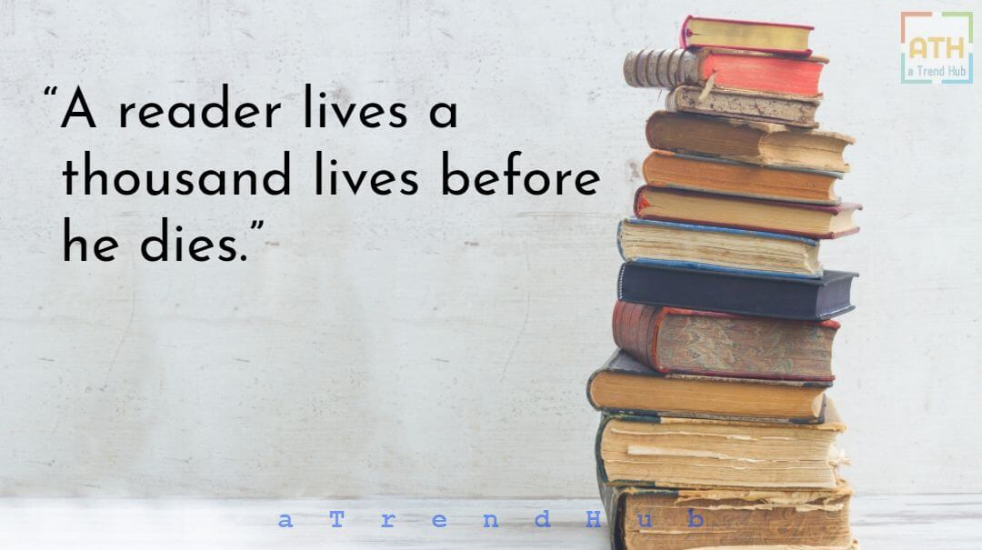

Slide 9

BOOKS VS MOVIES

Slide 10

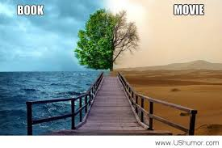
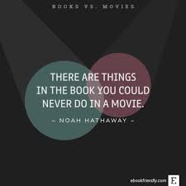

Slide 11


In My POV:
THE BEST
CHOICE !

Slide 12

Book review

Slide 13


Slide 14
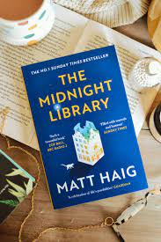
The Midnight Library
Author : Matt Haig
Lead : Nora Seed
Plot : A Magical Library
Genre : Fiction

Slide 15


Slide 16
The Only way to Learn is to Live
One Library, Infinite Lives
Choices
The Perfect Life
What If...?
Between Life and Death, There is a Library
The Book of Regrets
What is the best way to live ?
Perceptions

Slide 17


Slide 18


